Slide 1
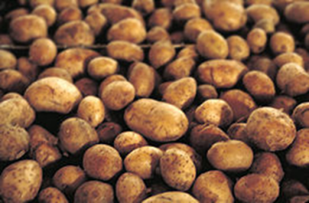
POTATO
By:Varga Boglárka

Slide 2
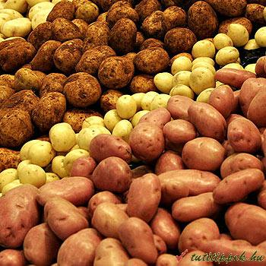
History
The natives in Peru and Chile already grew and ate the tuber 5000 years ago, but it got to be known in the europian civilization in the 16th century.
In the 1540th, by an expedition of Pizarro, they brought the tuber to Europe, what they thought to be gold, improperly. While they realized, that is not gold, they named it tartuffo, because it was look like a truffle (szarvasgomba).
After that, Spanish and Portuguese traders spread it in Asia and Africa as well.
But firstly, they thought it was a toxic plant, caused many illnesses, just because they used the wrong part of the potato, they cooked its leaves instead of the tuber.
But after a while, a French chemist found out, for what could be potato used for and convinced King Lajos to plant potato.

Slide 3
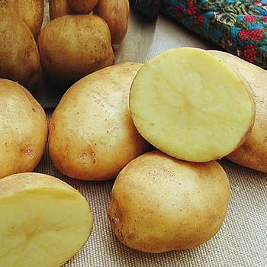
APPEARANCE :
It is a middle-sized plant, with dark green leaves and white flowers on it.
In its root, there are tubers, which are brown ,orange, or red on the outside, white, or orange on the inside.
USE:
Potato is an everyday food, there are many ways people can use it. You can make soups, pottage, or side dishes from it. You can fry, you can roast and even you can cook it.
Potato-sugar can be produced of it, too.

Slide 4
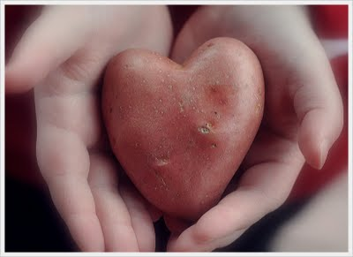
POTATO MYTHS:
If a woman is expecting a baby, she should not eat potatoes, because the baby will be born with a big head.
If you hold potato in your pocket, it can cure your rheum or eczema.
Laying a potato peel at the door of a girl in May Day shows her that you don’t like her.

Slide 5
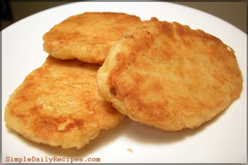
RECIPE:
Fried potato cakes:
Ingredients:
One dish left over mashed potatoes
One small onion
One egg
½ teaspoon garlic powder
Some salt and pepper
Some flour
How to make it:
Mix all ingredients together.
Form potato cakes and fry in hot oil or bacon fat until they become golden brown on both sides.
After that you put them to a plate and service.

